Slide 1

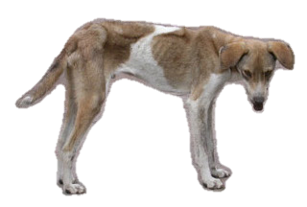

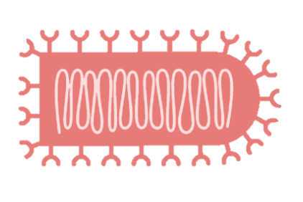
How does RABV mutate?
How fast is it mutating?
?
Should we still be using the clock rate to measure rabies evolution?

